Slide 1

MEDICAL EXPENSES PREDICTION
GROUP 1:
Gopi Sandeep Guntuku
Sukumar Reddy Kottala

Slide 2
Problem Statement
Predict the future medical expenses of patients based on certain features.
Factors affecting the medical expenses of the patients :-
Age
Gender
Body Mass Index
Region
Smoking Behavior
This project aims to solve the problems using ML techniques to predict the medical health expenses of customers living in different regions along with Exploratory Data Analysis.

Slide 3
Data Source
Data for this project was taken from Kaggle.com and on github at: https://github.com/stedy/Machine-Learning-with-R-datasets/blob/master/insurance.csv
The data itself consists of 1,338 rows and the following features:
age: Age of primary beneficiary
sex: Female, Male
bmi: Body mass index
children: Number of children covered by health insurance / Number of dependents
smoker: Smoking (yes/no)
region: The beneficiary's residential area in the US, northeast, southeast, southwest, northwest
expenses: Individual medical costs billed by health insurance

Slide 4
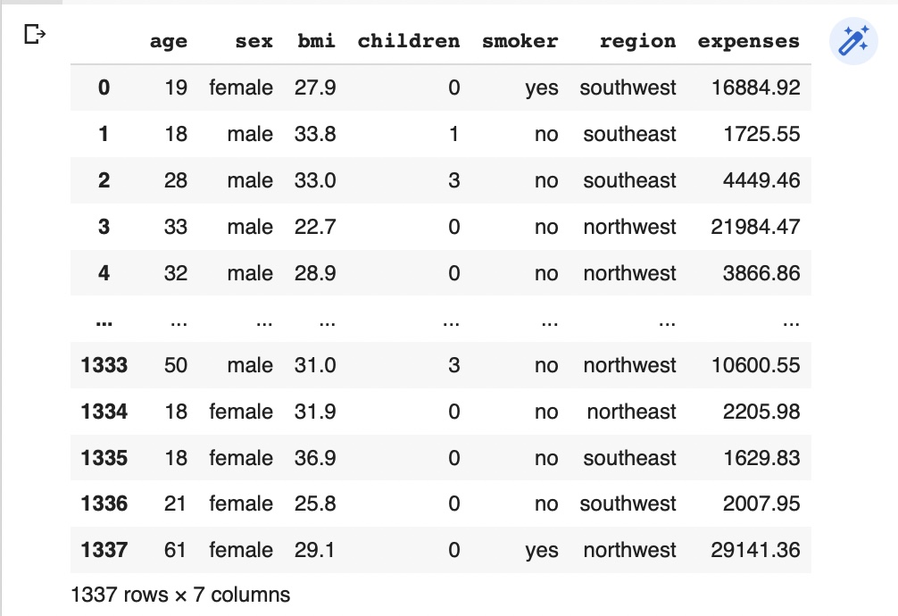
A snippet of Raw dataset

Slide 5
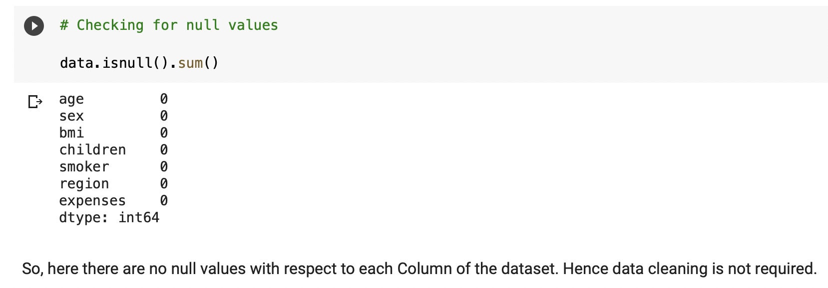
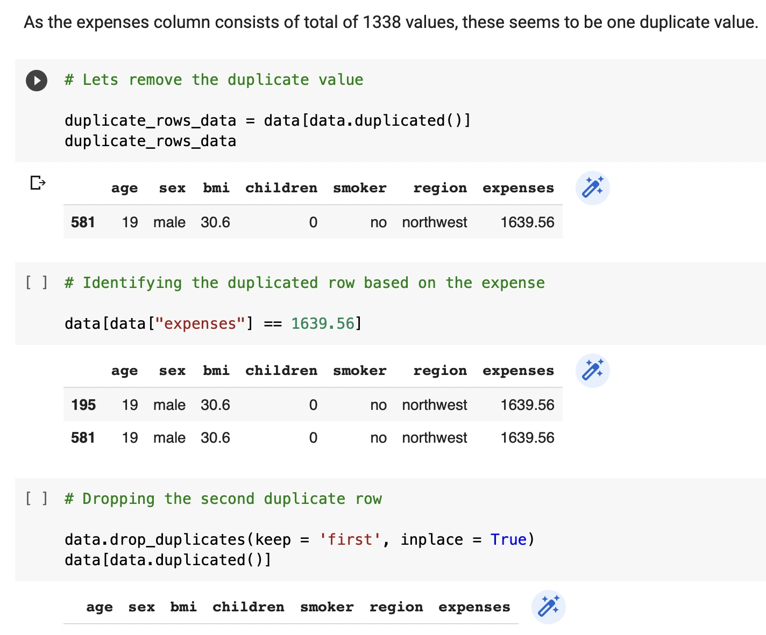
Data Preparation
Data Preprocessing:
Removing the Null values from the dataset using isnull().sum() & use dropna() if there is any null values.
Check for duplicates using duplicated() and drop the duplicates and check the count.

Slide 6
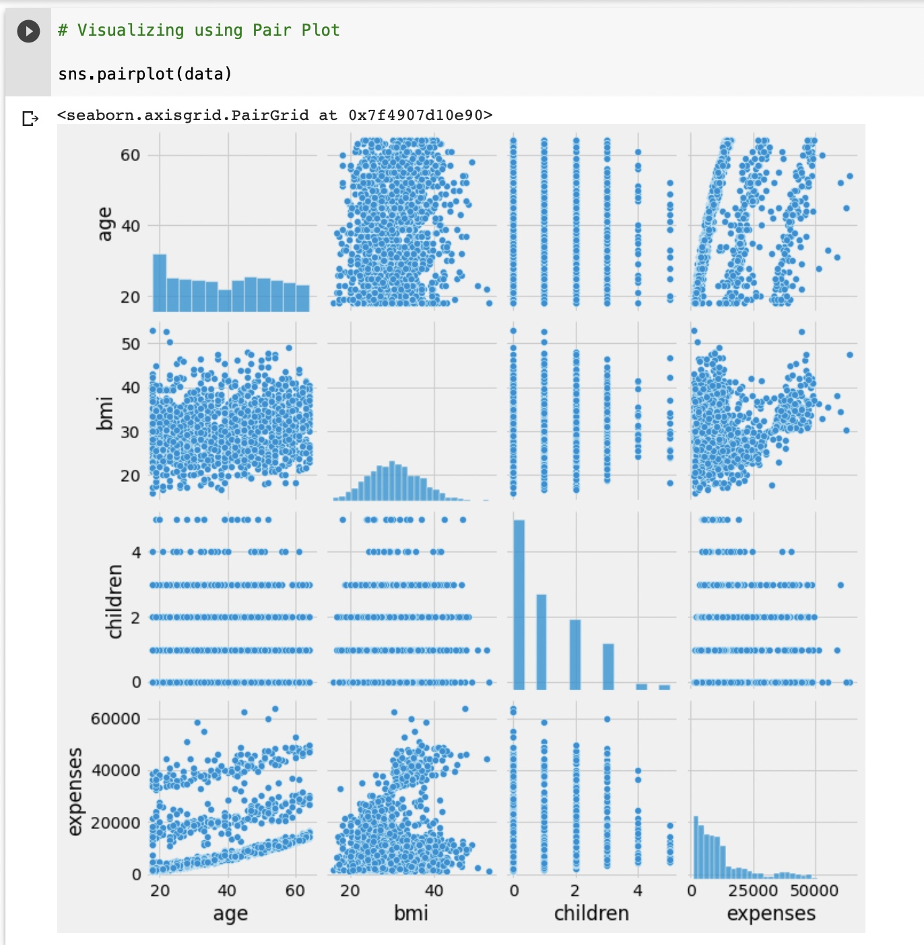
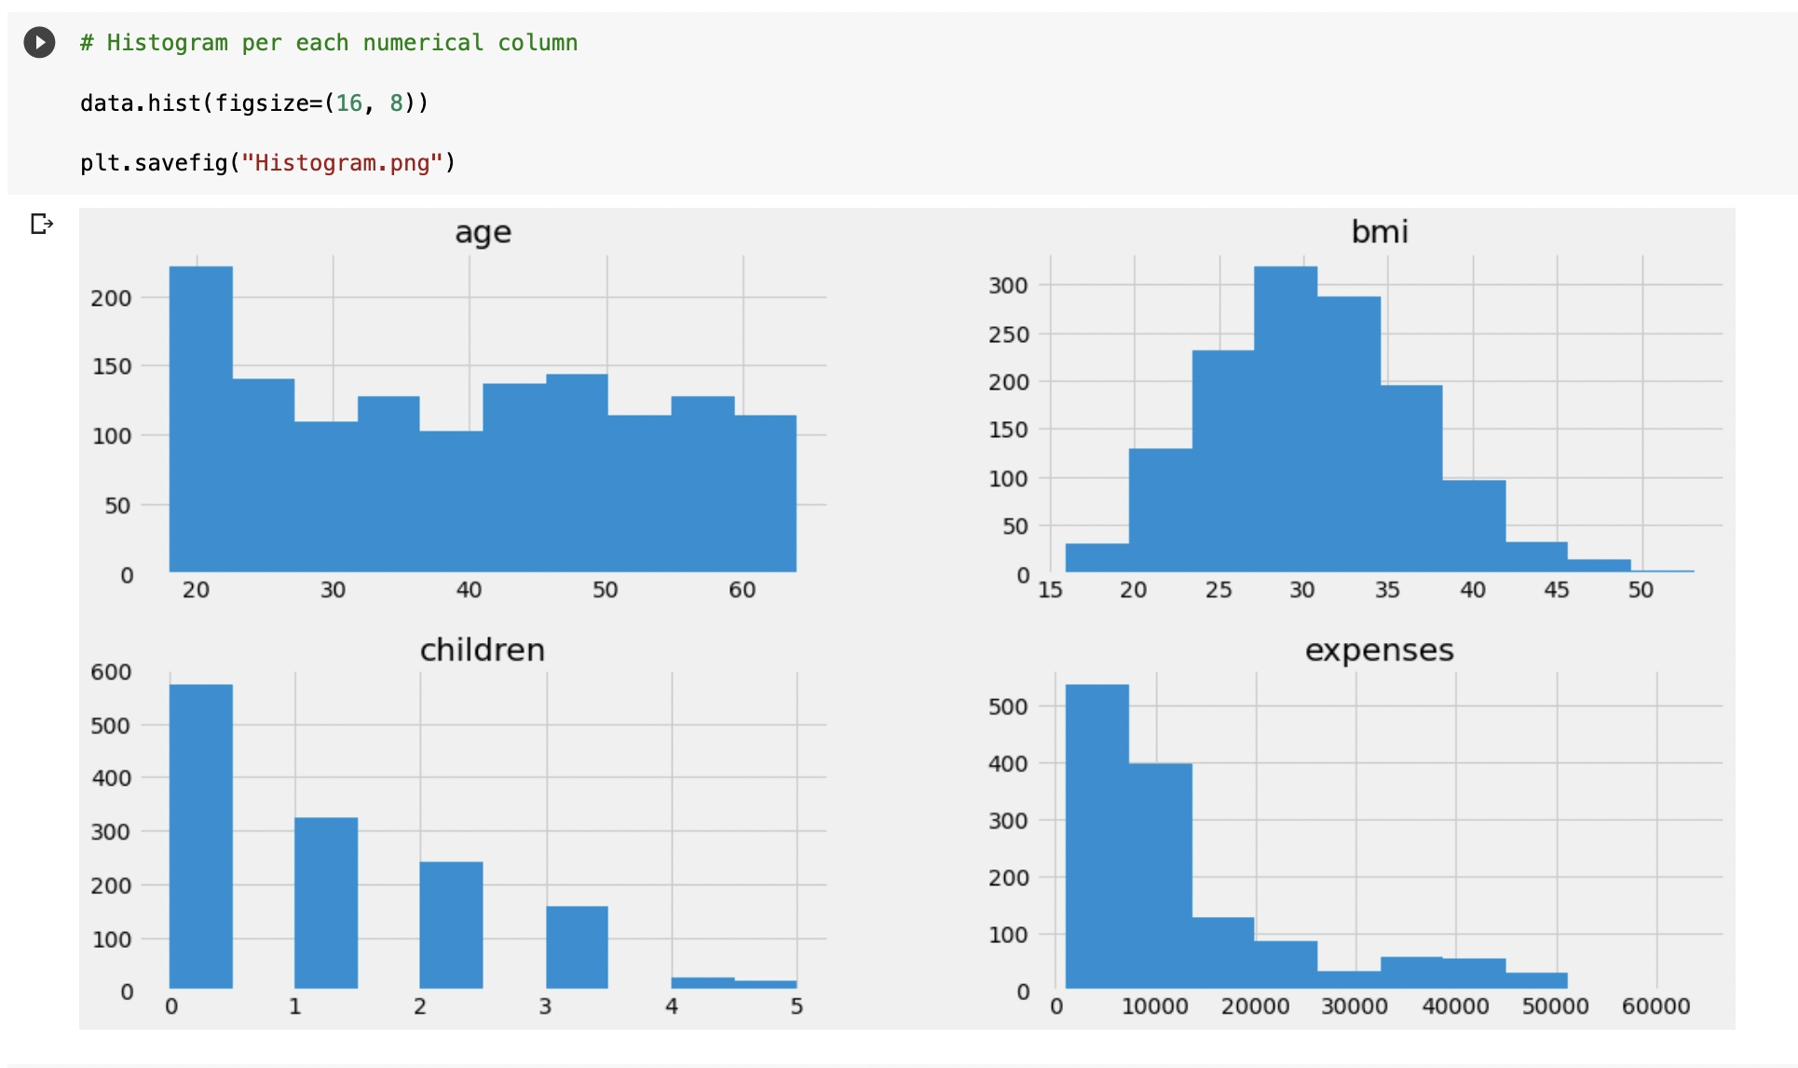
Exploratory Data Analysis
Data Visualization:
Using Pair plot Using Histogram

Slide 7
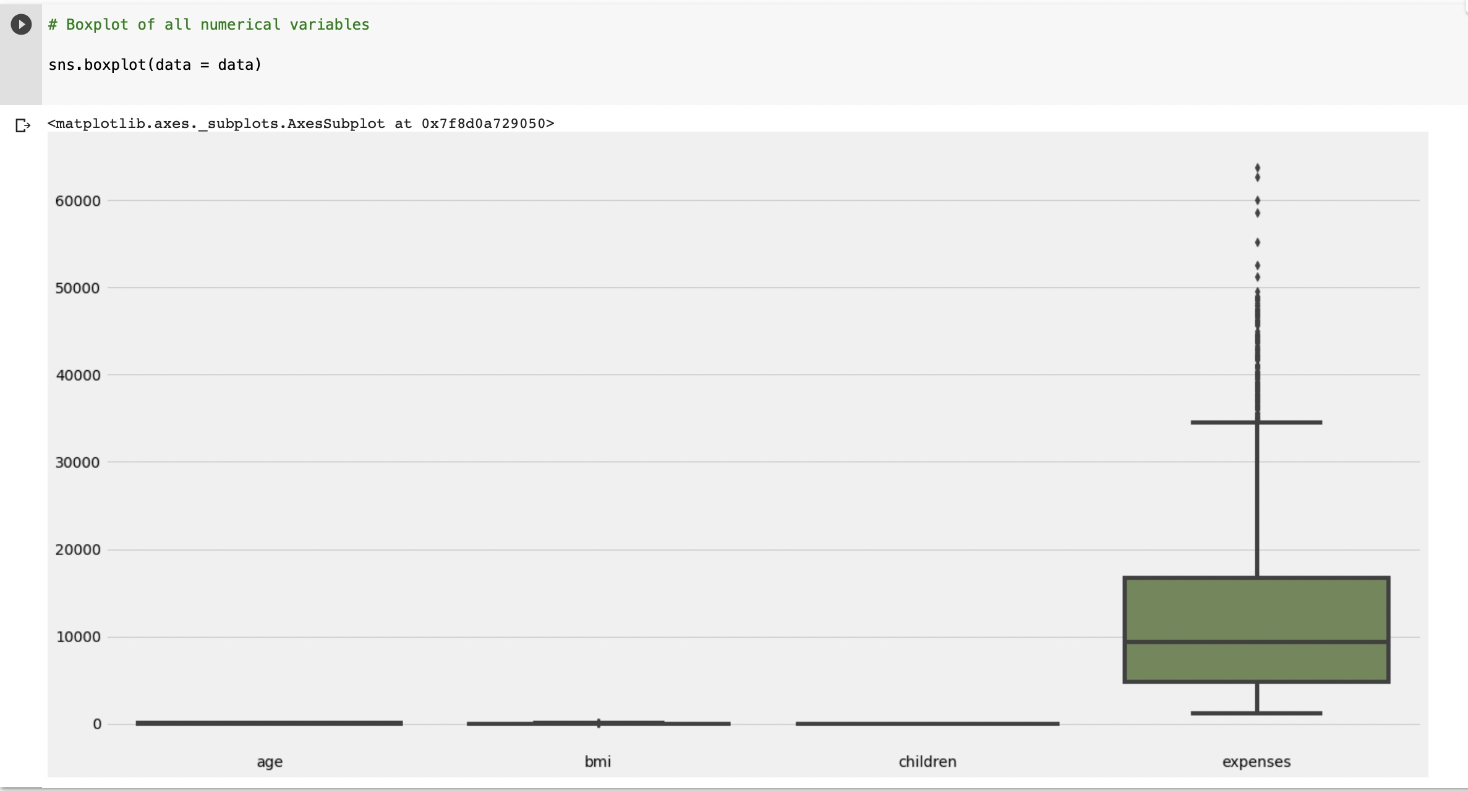
Exploratory Data Analysis
Data Visualization:
Using Box plot on all numerical variables.

Slide 8
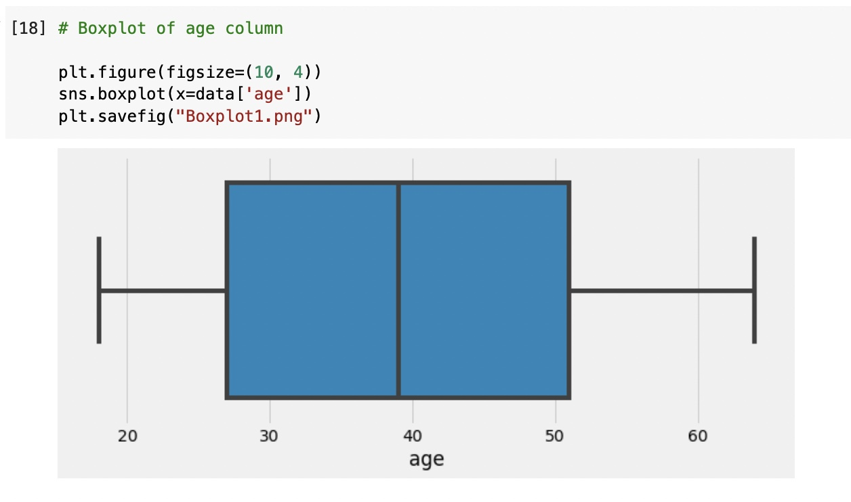
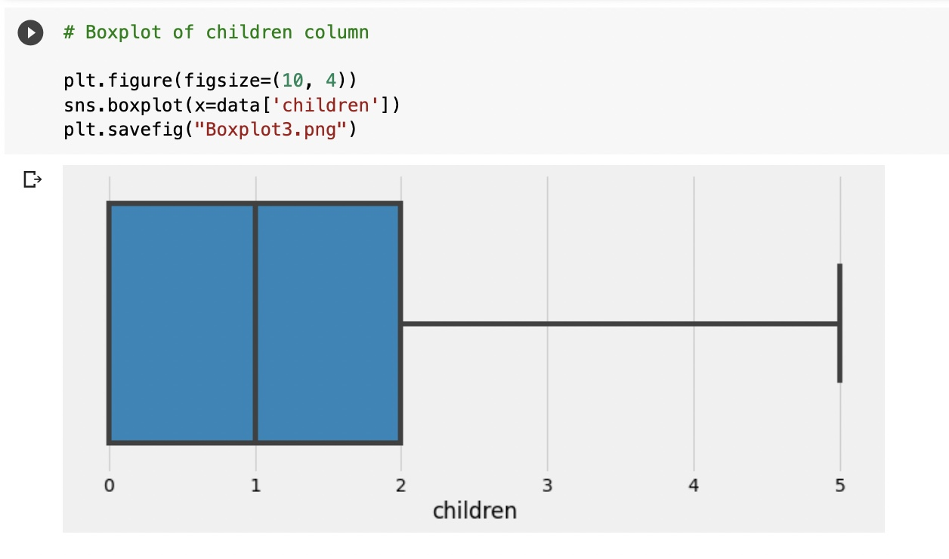
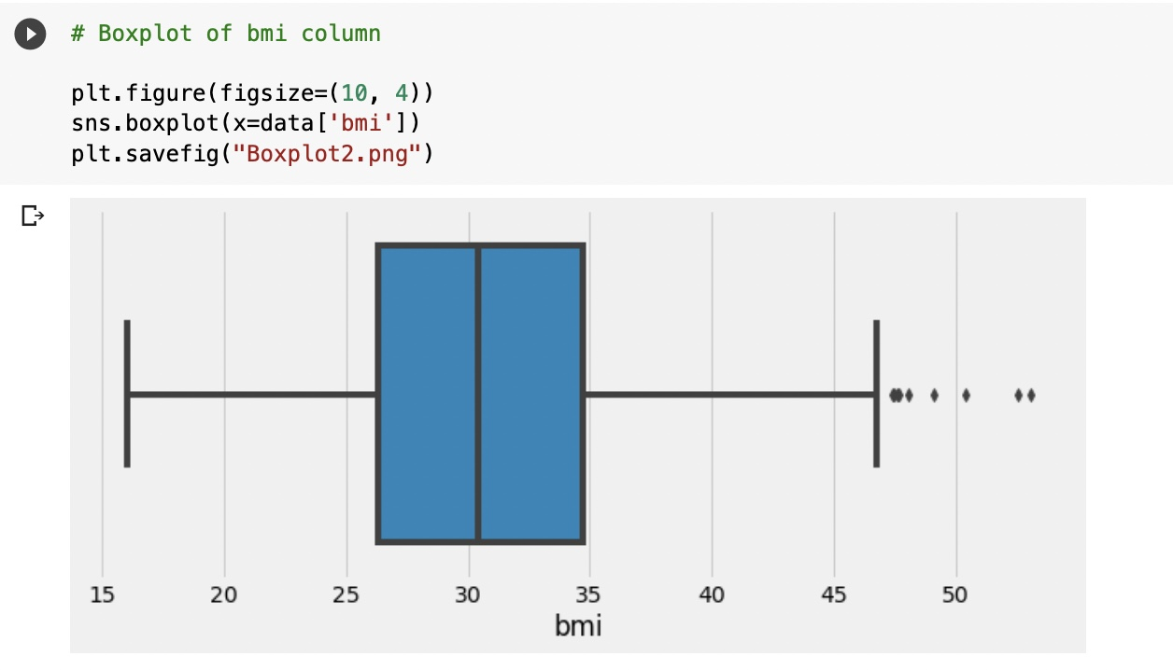
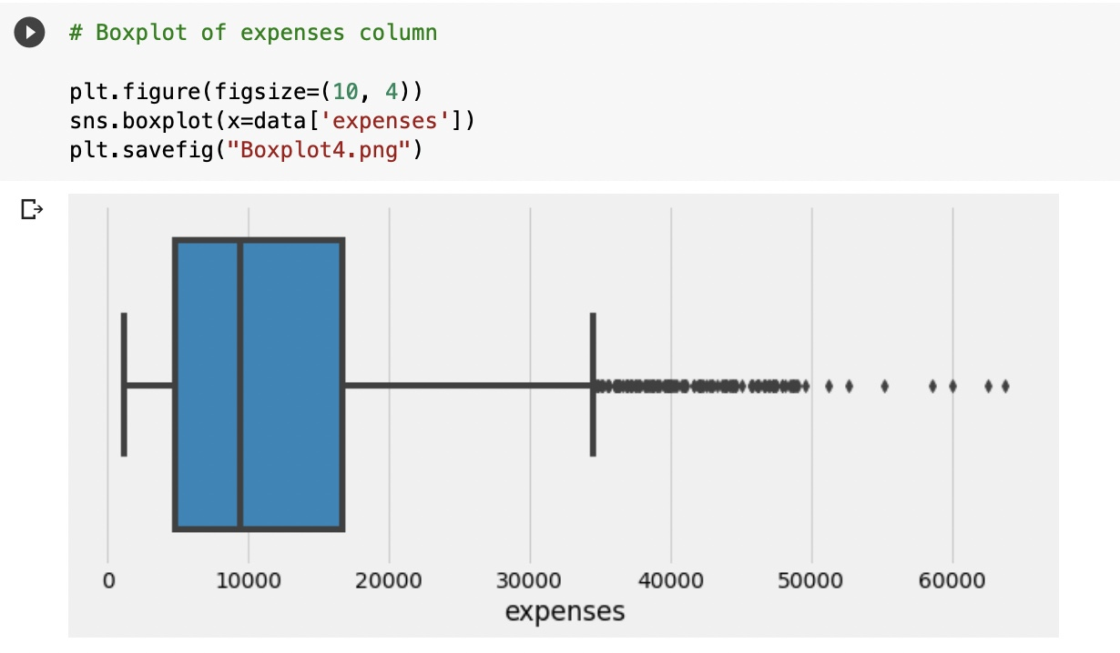
Exploratory Data Analysis
Data Visualization:
Using Box plot

Slide 9
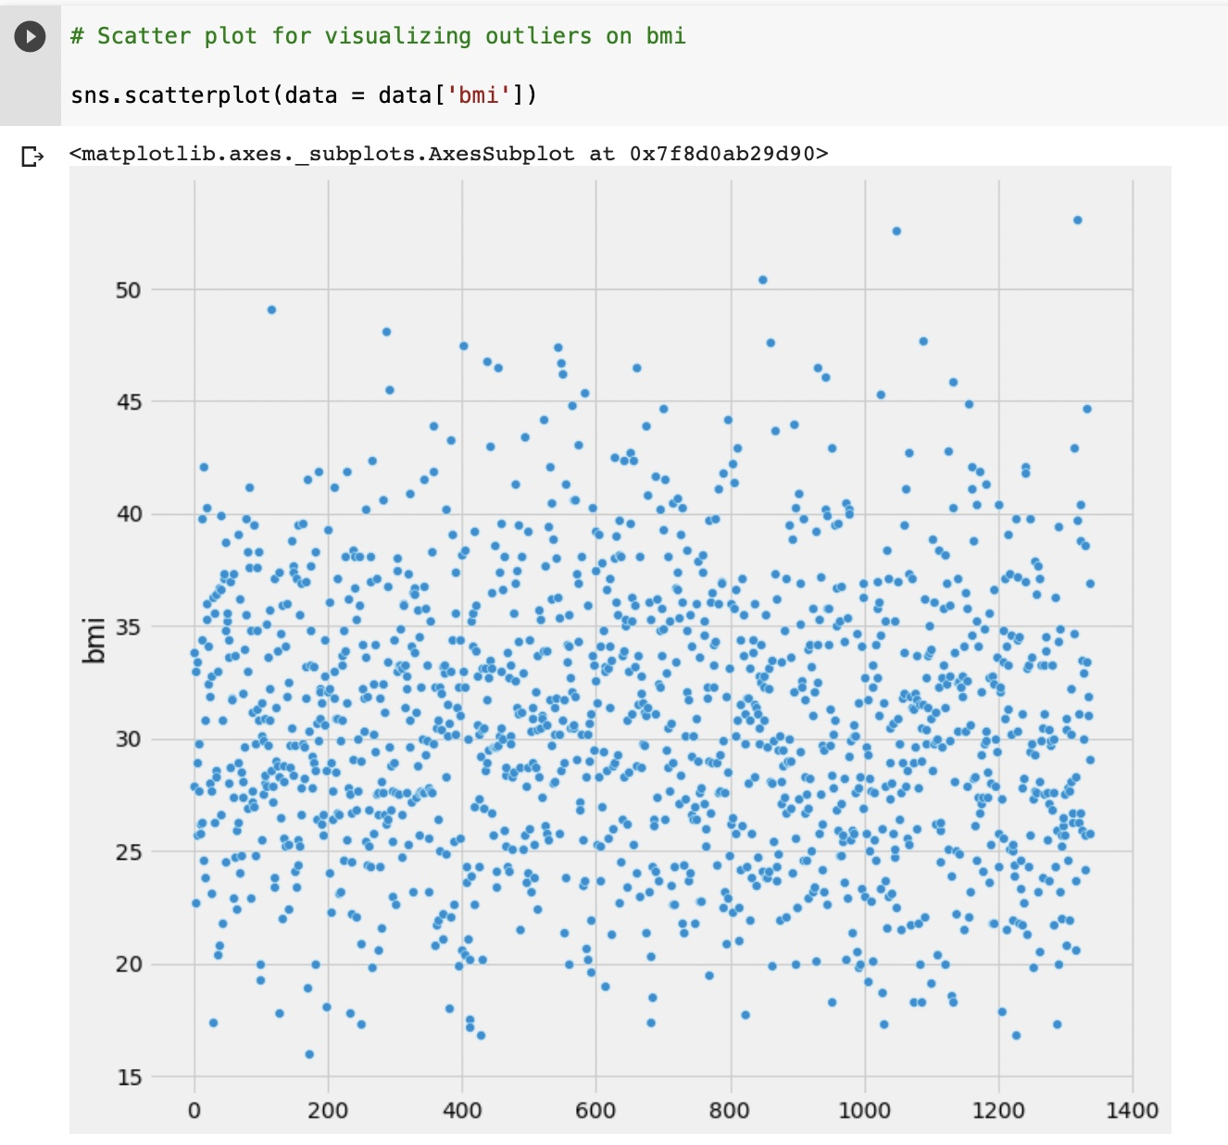
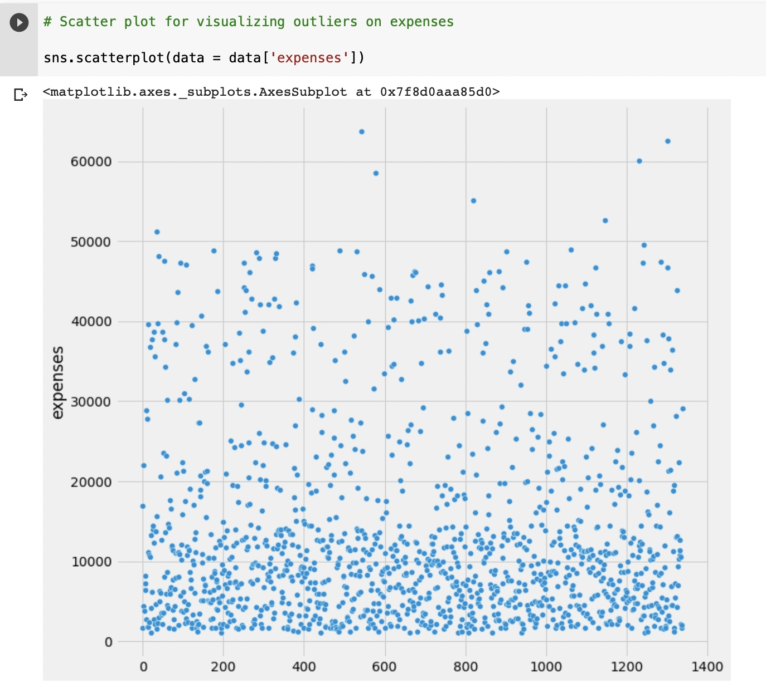
Exploratory Data Analysis
Data Visualization:
Using Scatter plots to show outliers on bmi and expenses.

Slide 10
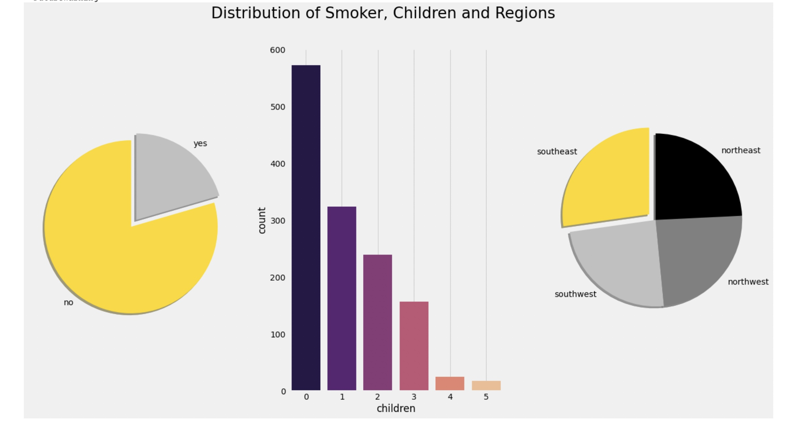
Exploratory Data Analysis
Data Visualization:
Univariate Analysis

Slide 11
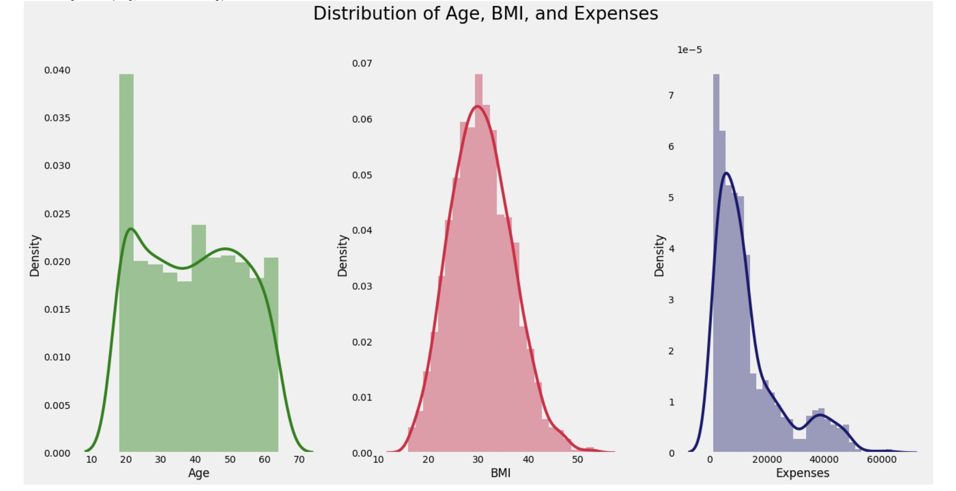
Exploratory Data Analysis
Data Visualization:
Univariate Analysis

Slide 12
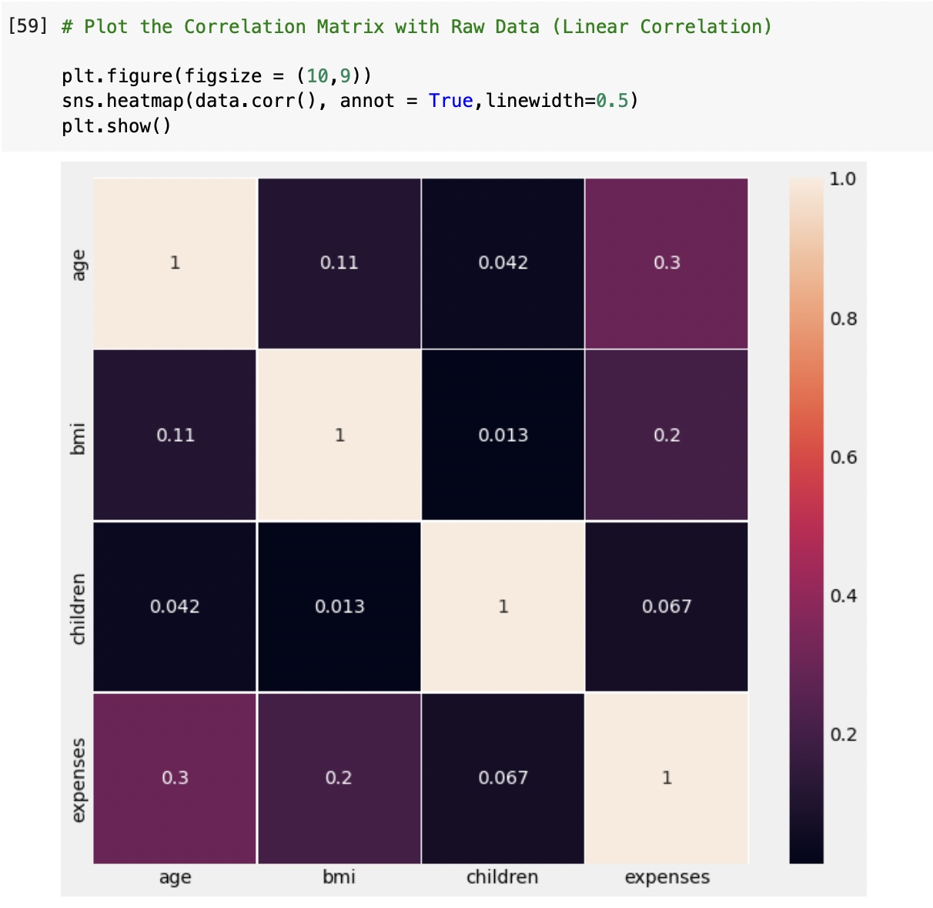
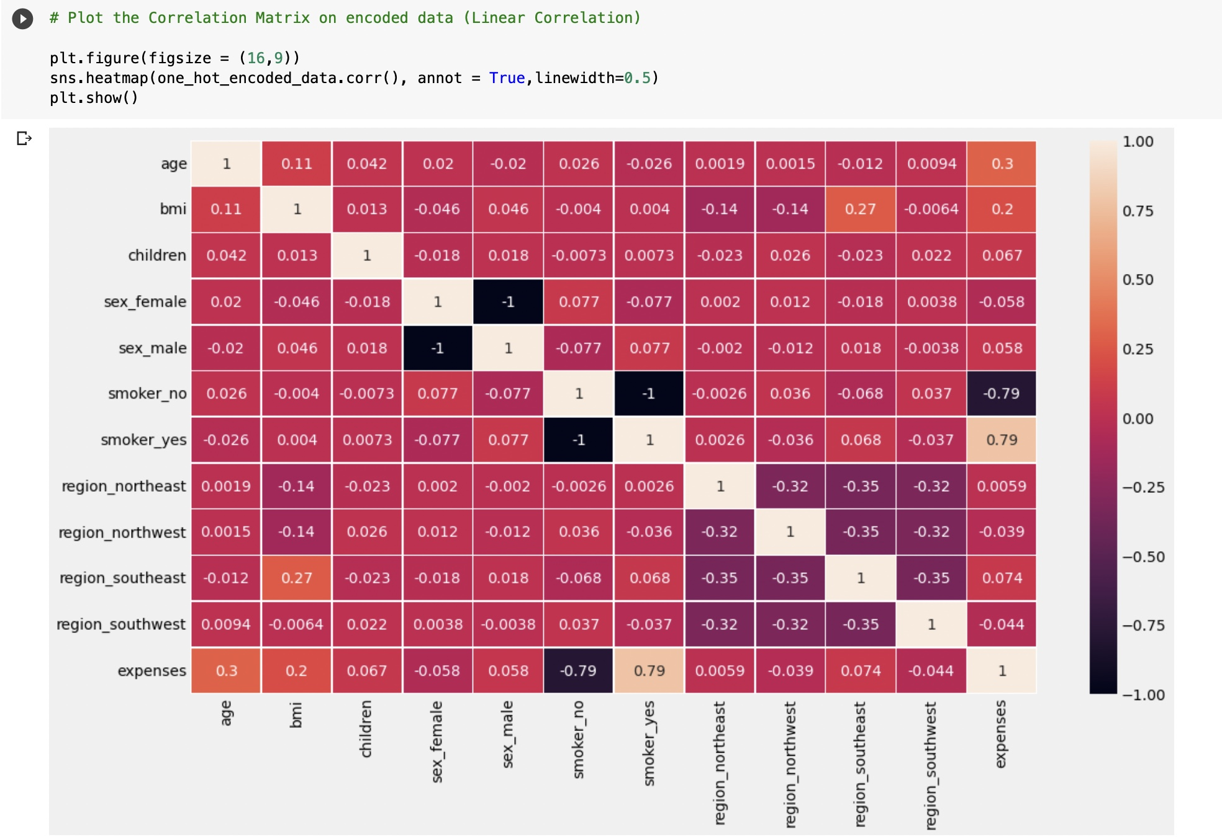
Exploratory Data Analysis
Data Visualization:
Correlation matrix on raw data and encoded data

Slide 13
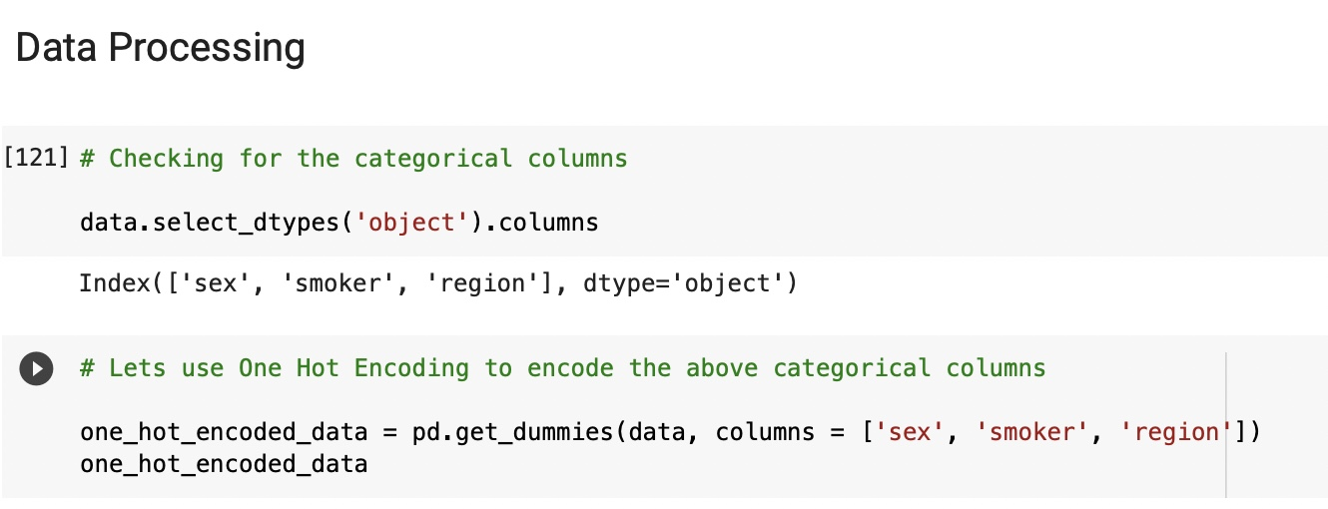
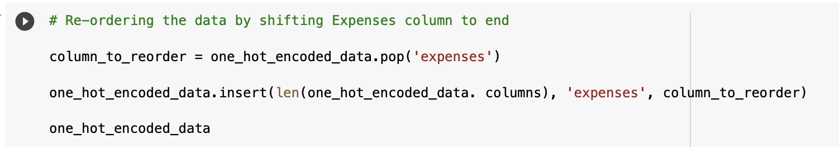
Data Processing
One hot encoding:
Now we are going to apply one hot encoding on sex, smoker, region columns to convert into numerical data.
After converting, re-order the data using pop()

Slide 14
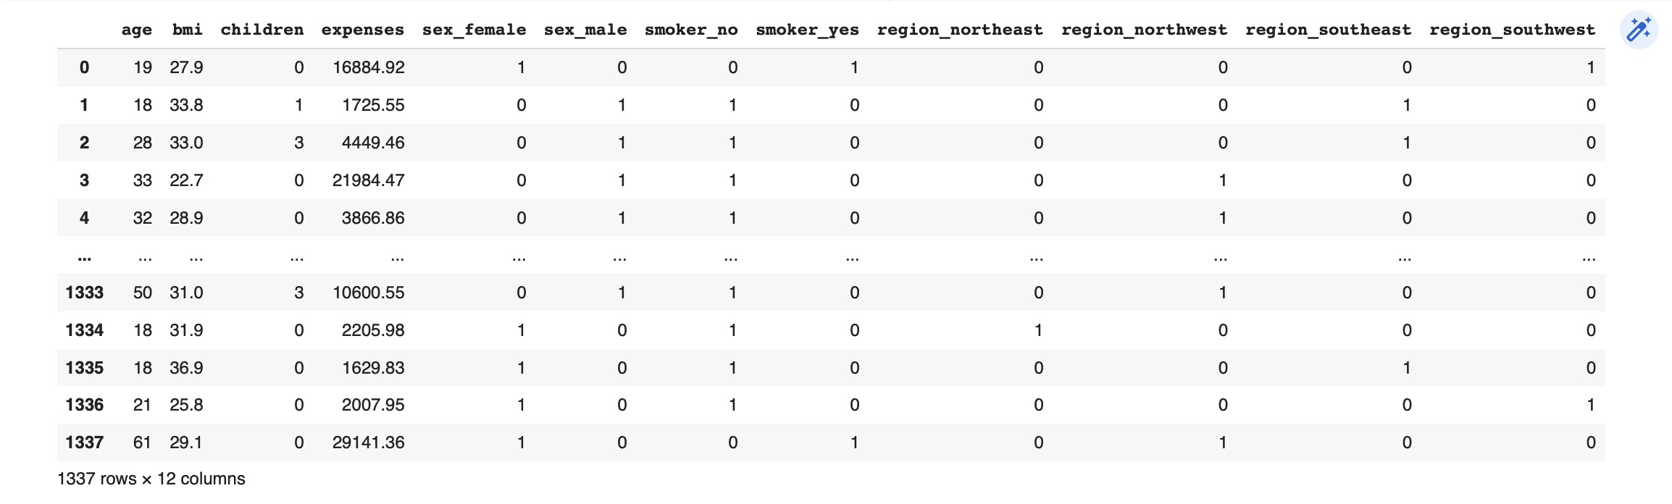
A snippet of dataset after one hot encoding

Slide 15
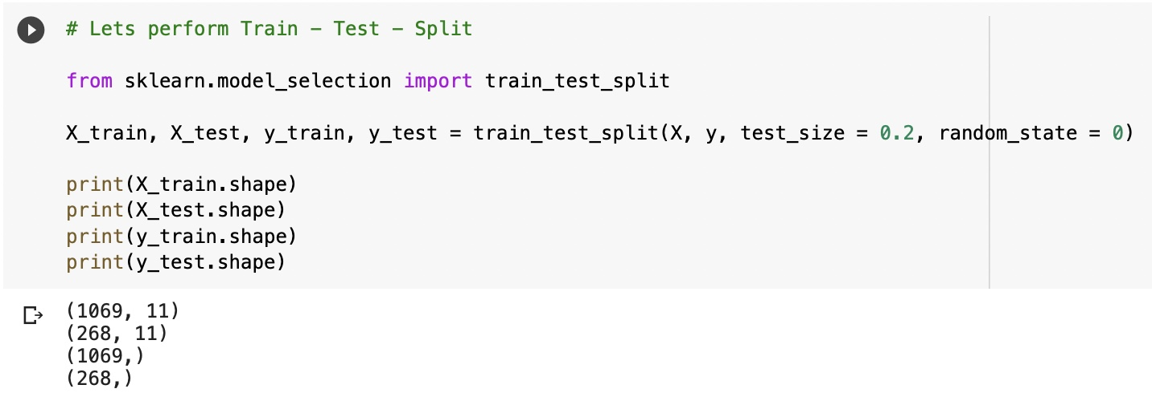
Data Processing
Data Splitting:
Split the entire dataset into train data and test data with a ratio of 80:20 for scaling and applying for predictive models.

Slide 16
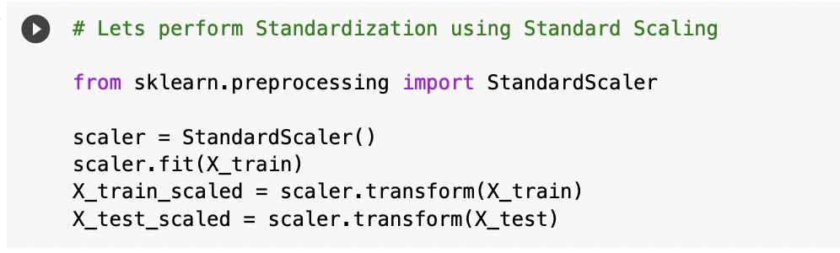
Data Processing
Feature Scaling:
We used fit and transform function to apply scaling using standard scaler on training data.
And apply only transform function on testing data.

Slide 17
Data Modelling
Linear Regression model.
K Nearest Neighbours model (KNN).
Random Forest.
Ensemble of all above models.
Comparison of all models.

Slide 18
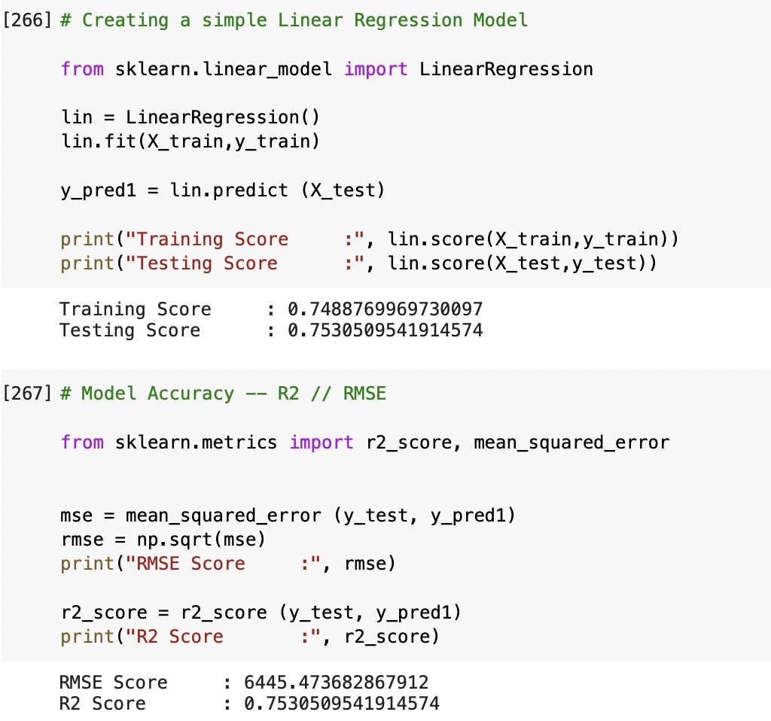
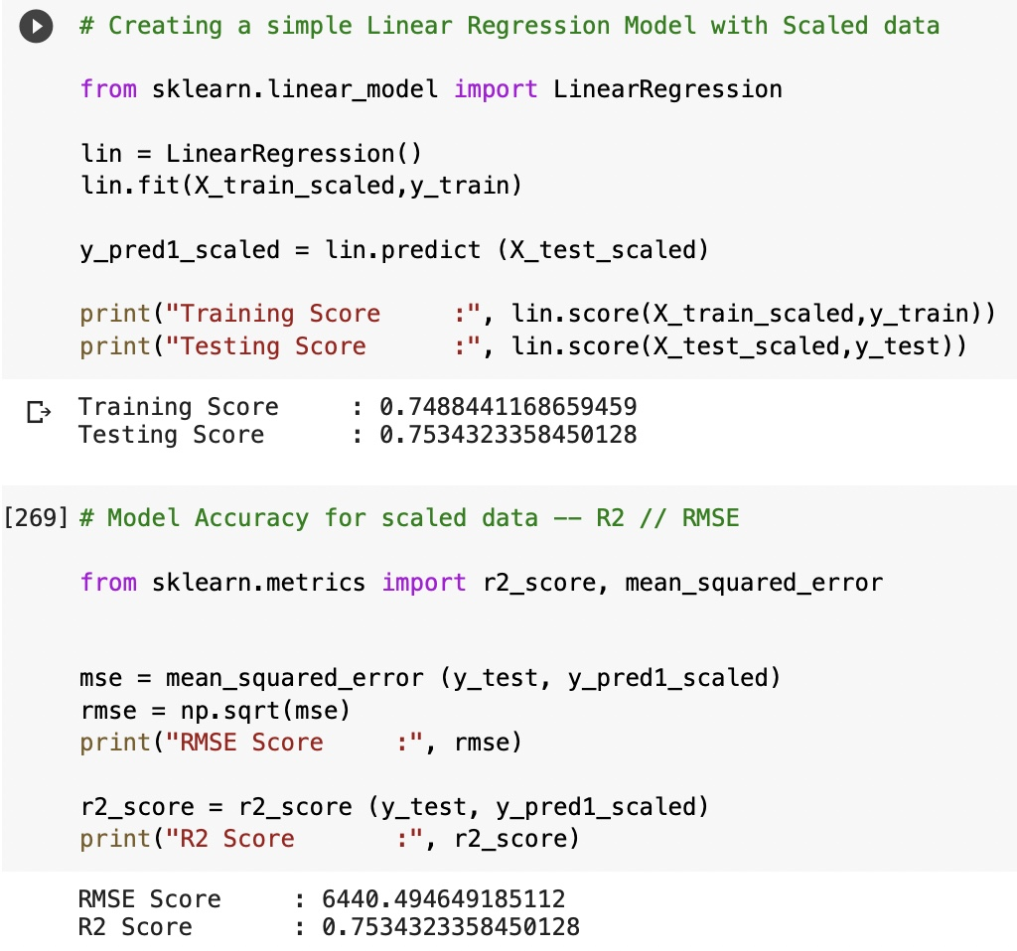
Data Modelling
Linear Regression model:
Here we predicted future medical expenses using Linear Regression on unscaled data and scaled data.
We computed R2 and RMSE values obtained as 0.7530 and 6445.47 for unscaled data.
For scaled data we got 0.7534 and 6440.49 as R2 and RMSE values.

Slide 19
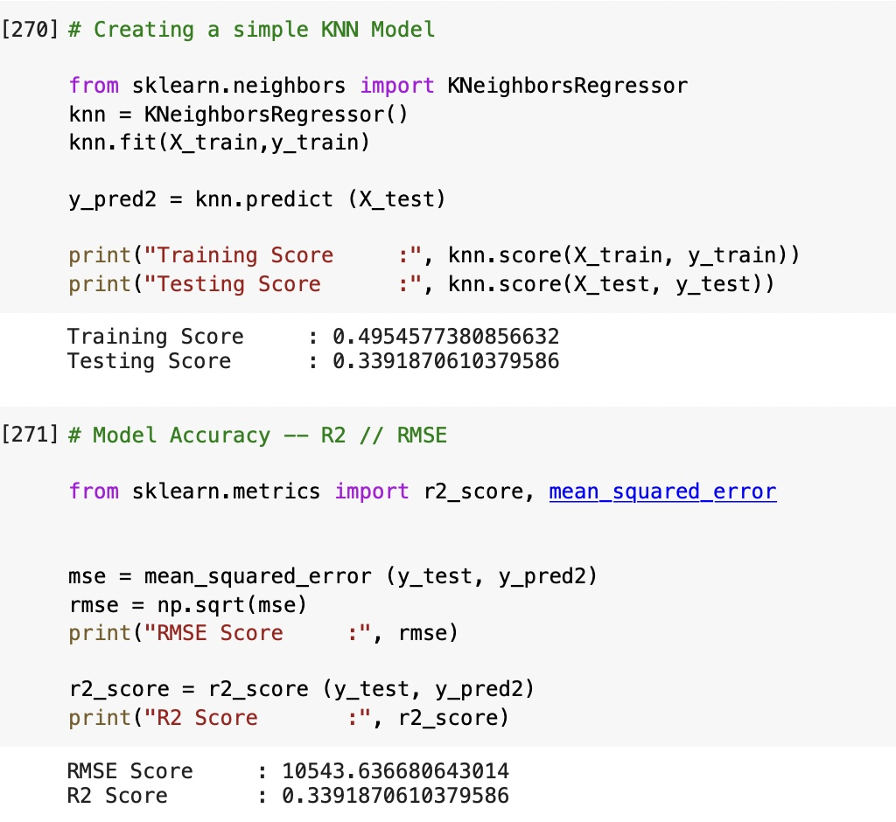
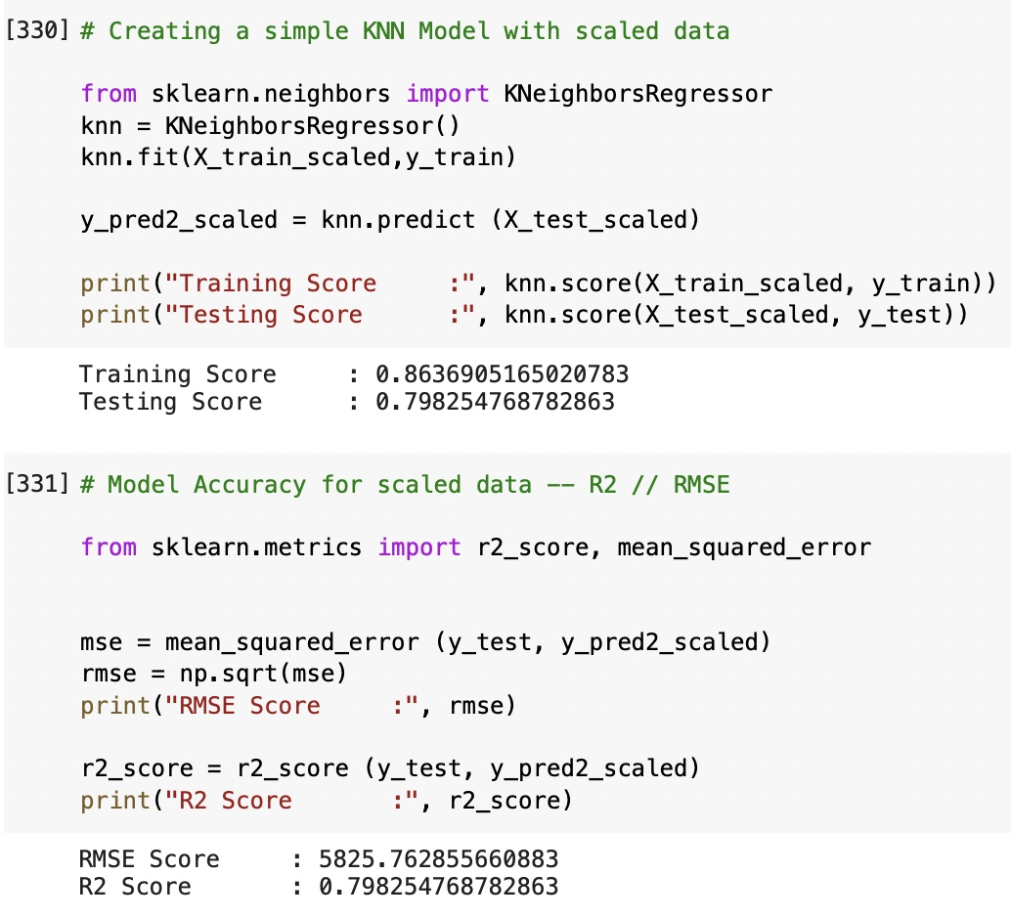
Data Modelling
K-Nearest Neighbours model (KNN):
Here we predicted future medical expenses using KNN on unscaled data and scaled data.
We computed R2 and RMSE values obtained as 0.3391 and 10543.63 for unscaled data.
For scaled data we got 0.7982 and 5825.76 as R2 and RMSE values.

Slide 20
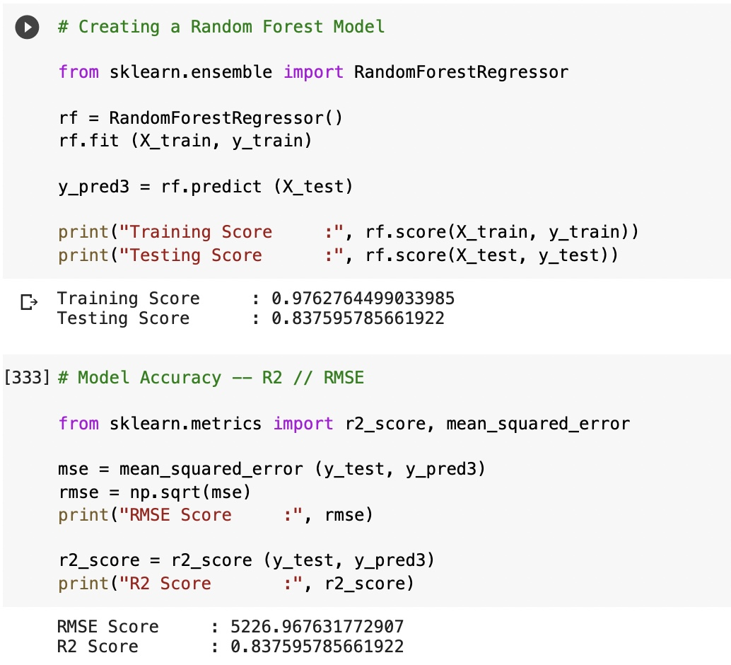
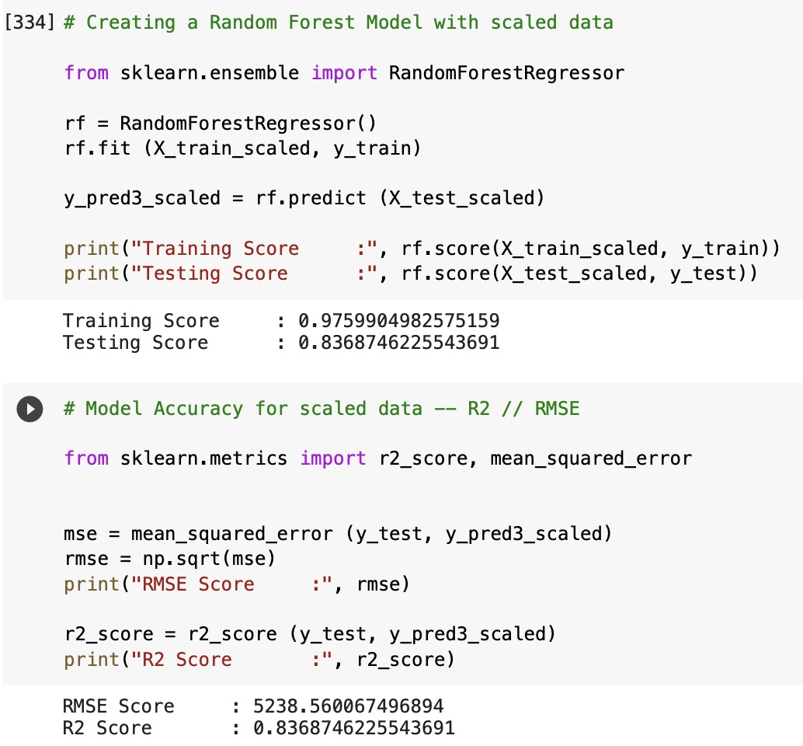
Data Modelling
Random Forest model :
Here we predicted future medical expenses using Random Forest on unscaled data and scaled data.
We computed R2 and RMSE values obtained as 0.8375 and 5226.96 for unscaled data.
For scaled data we got 0.8368 and 5238.56 as R2 and RMSE values.

Slide 21
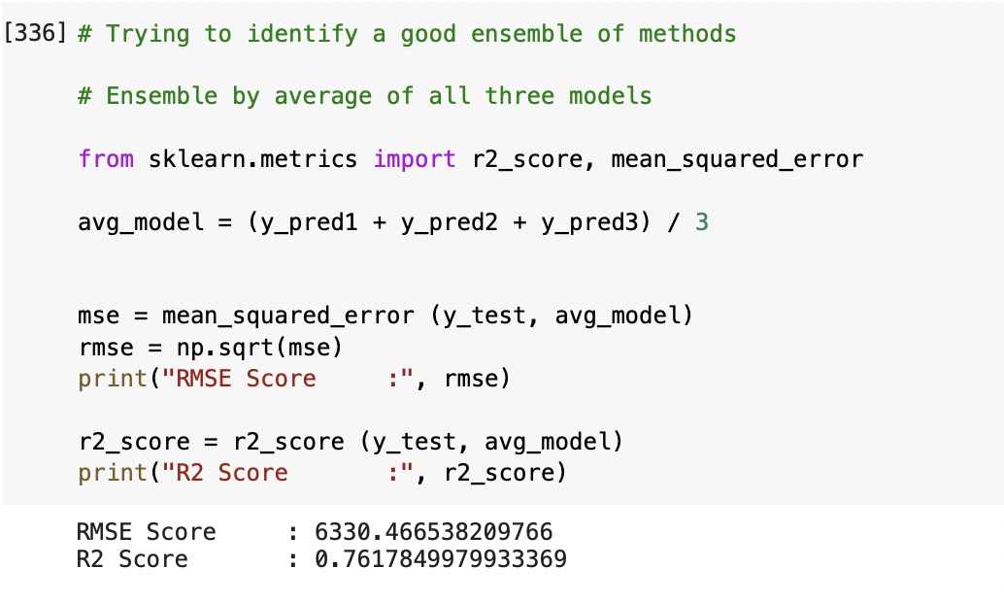
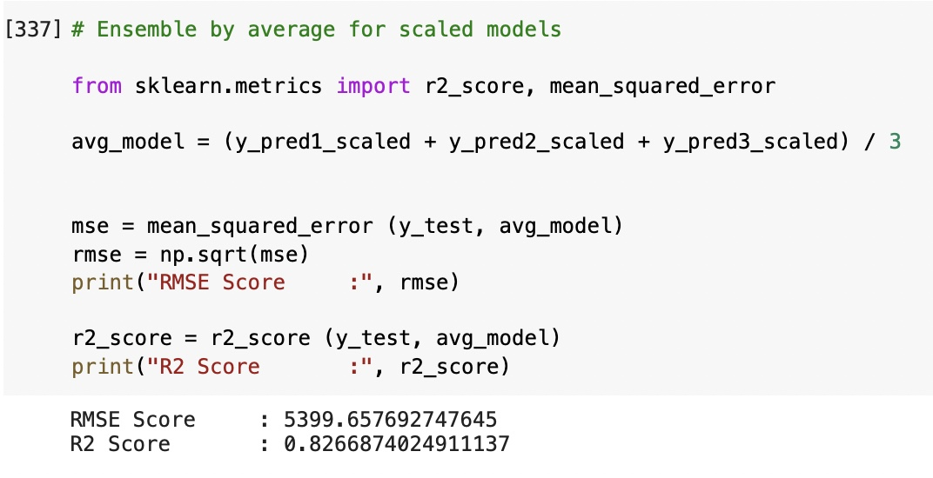
Data Modelling
Ensemble of all 3 models :
Here we tried to identify a good ensemble by average of all 3 models.
We compared R2 and RMSE values of unscaled data and scaled data ensemble models.
For scaled data we got better R2 and RMSE values 0.8266 and 5339.65.

Slide 22
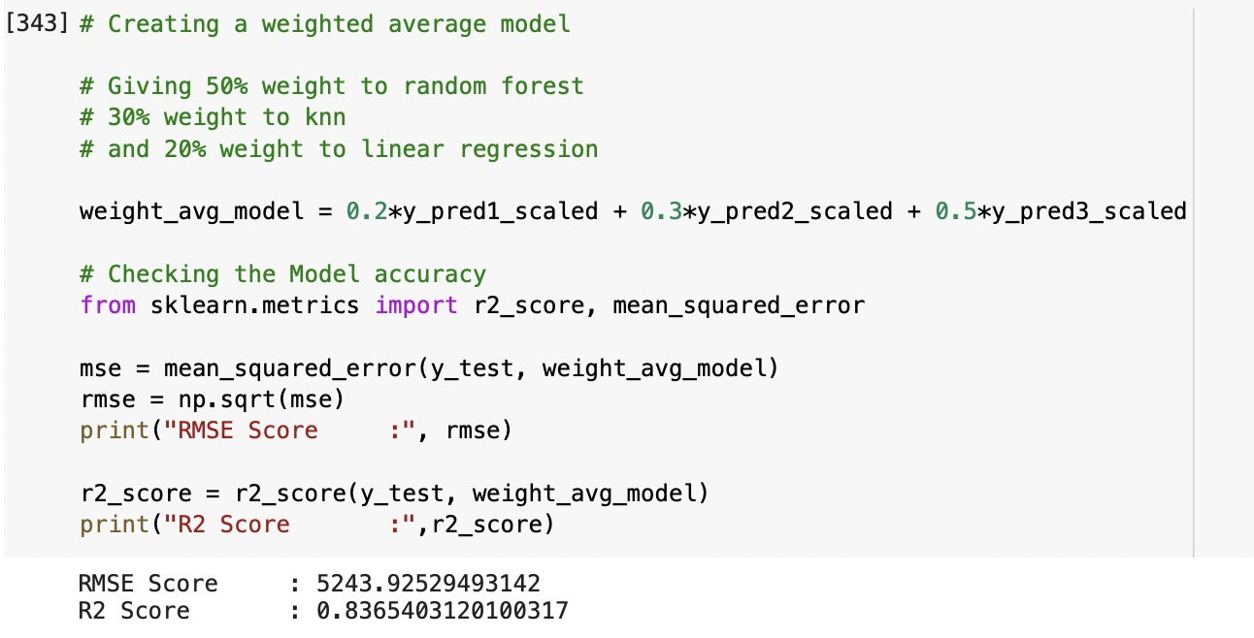
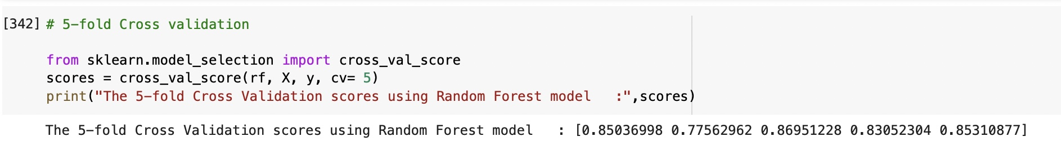
Data Modelling
Weighted Average of all 3 models :
Cross Validation of all 3 models :

Slide 23
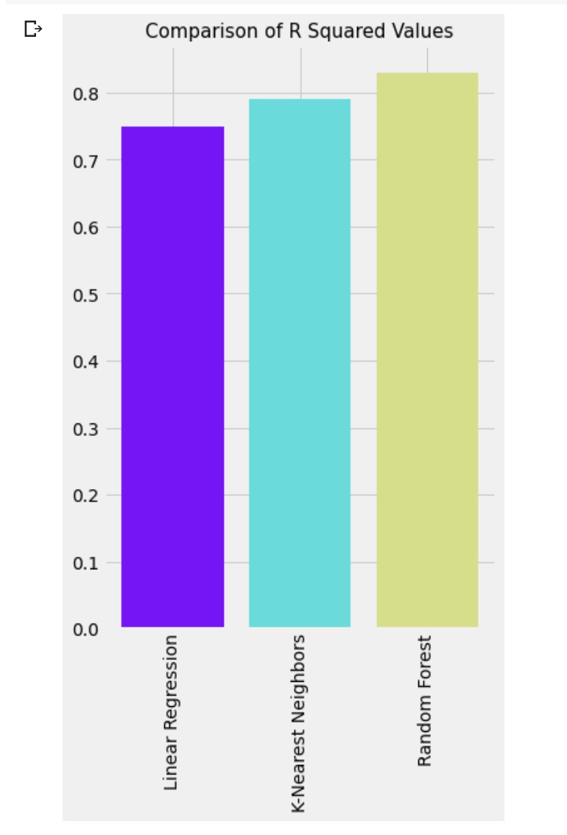
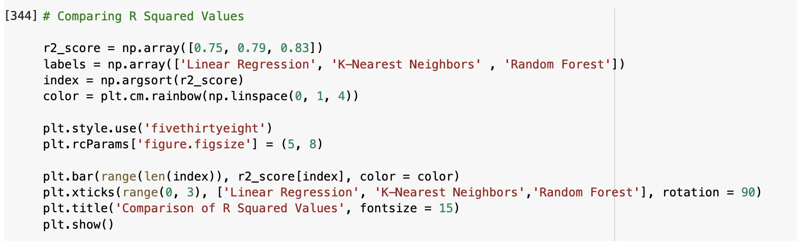
Data Modelling
Comparison of all 3 models with scaled data :

Slide 24
Evaluation
We came to know that the Most Important Factor to Predict the Medical Expenses of a subject is Smoking Behavior and Age, that means, smoking is Bad for Health, as already know that and which inevitably increases medical expenses as due to smoking one is likely to fall ill more than the nonsmokers.
We also found that with increasing of age, one needs to take some more care and precautions for your health as with the increase of age health becomes fragile, so they go for frequent medical check-up, likely to fall ill quickly as with the increase of age immunity falls so they adopt measures to stay healthy by taking medicines and engaging in some physical activities.
Apart from that we also understood that Gender, Number of Children, the Region also have a good impact on determining Medical Expenses.

Slide 25
Conclusion
We have built three models among which the Random Forest model shows the best result through which we can say 83.65% variability of expenses can well be explained by predictor variables and which yields comparatively low RMSE value so our predicted expense through this model will not vary too much from the actual expense.

Slide 26
Recommendations
The number of features are limited in this dataset. With an addition of 5 or more valid features, the predictions can be improved much further.
We can try converting the expense column to a normal distribution using log or square root transformation.
We can try some more predictive models on this dataset to get more accuracy.

Slide 27
Future Work
We plan to take this project further as health is center of everyone’s life and every part of our life relies on good health.
We intend to develop an application to predict possible medical costs using PyCharm editor on AWS platform by plugging in basic details such as age, sex, smoker, children, region and then pressing a submit button.
This application will help people understand the factors that are making them unfit so that they can reduce their medical expenses.
We can also use this health expense predictor in hospitals so that patients can adjust their medical expenses.

Slide 28
Questions?

